Slide 1
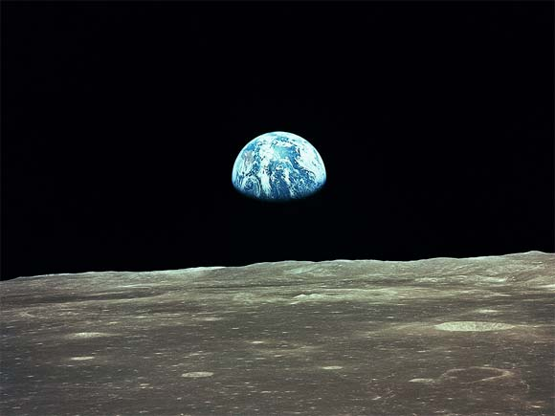
Space

Slide 2
First man on the moon
1969: Man takes first steps on the Moon
American Neil Armstrong has become the first man to walk on the Moon. The astronaut stepped onto the Moon's surface, in the Sea of Tranquility, at 0256 GMT, nearly 20 minutes after first opening the hatch on the Eagle landing craft.

Slide 3
No gravity in space
No gravity in space? Who told you that there is no gravity in space? I assure you! There is gravity in space! There is gravity everywhere! There is no place in the entire universe that has no gravity! The astronauts are weightless while in orbit around the earth. But, intrestingly, this is precisely because there IS gravity. When an object is in orbit it is actually falling. But as with any thrown object as it falls vertically, it also travels horizontally. When you throw a rock, for example, it travels horizontally because you threw it and it travels vertically because gravity is acting upon it.

Slide 4

What is NASA
National
Aeronautics and
Space
Administration

Slide 5
Is there air in space
Air is a combination of gases which forms a layer around the Earth. Air is actually retained on Earth only by the force is, to surround the Earth and maintain life on earth.
However, space, by definition is outside of the Earth's atmosphere. It is the space between the planets and the stars. There is no air in space because all gases are held by gravity to one or other of the planets or stars. The various planets and stars may have air which is insufficient to maintain life, or life as we know it !
Because gravity is actually stronger at ground level than it is further away, there is more air closer to the ground. Gradually, when leaving Earth's atmosphere, the air available dwindles to almost nothing. Some air can be located at about 100 miles above the earth, but after 6 miles from the surface, humans would not be able to breathe enough to live.

Slide 6
How many galaxies in space
This is unknown, but development is learning
We are one of many, many galaxies in the big unknown space.
But we do know in our galaxy we have around 200 to 400 billion stars.

Slide 7
The number of females in space
There were

